Slide 1
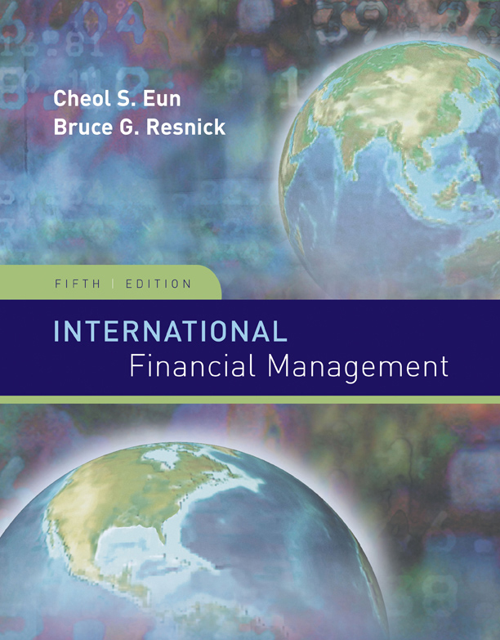
INTERNATIONAL
FINANCIAL
MANAGEMENT
Fifth Edition
EUN / RESNICK
McGraw-Hill/Irwin
Copyright © 2009 by The McGraw-Hill Companies, Inc. All rights reserved.

Slide 2
The Market for Foreign Exchange
5
Chapter Five
Chapter Objective:
This chapter serves to introduce the student to the institutional framework within which exchange rates are determined.
This chapter lays the foundation for much of the discussion throughout the remainder of the text, thus it deserves your careful attention.
5-<number>

Slide 3
FX Market Participants
The FX market is a two-tiered market:
  Interbank Market (Wholesale)
    About 100-200 banks worldwide stand ready to make a market in foreign exchange.
    Nonbank dealers account for about 40% of the market.
    There are FX brokers who match buy and sell orders but do not carry inventory and FX specialists.
  Client Market (Retail)
Market participants include international banks, their customers, nonbank dealers, FX brokers, and central banks.
5-<number>

Slide 4
Correspondent Banking Relationships
Large commercial banks maintain demand deposit accounts with one another which facilitates the efficient functioning of the FX market.
5-<number>

Slide 5
Correspondent Banking Relationships
International commercial banks communicate with one another with:
  SWIFT: The Society for Worldwide Interbank Financial Telecommunications.
  CHIPS: Clearing House Interbank Payments System
  ECHO Exchange Clearing House Limited, the first global clearinghouse for settling interbank FX transactions.
5-<number>

Slide 6
The Spot Market
Spot Rate Quotations
The Bid-Ask Spread
Spot FX trading
Cross Rates
5-<number>

Slide 7
Spot Rate Quotations
Direct quotation
  the U.S. dollar equivalent
  e.g. “a Japanese Yen is worth about a penny”
Indirect Quotation
  the price of a U.S. dollar in the foreign currency
  e.g. “you get 100 yen to the dollar”
See exhibit 5.4 in your textbook.
5-<number>

Slide 8
1
=
Spot Rate Quotations
.5072
1
.
9717
Currencies |  |  | January 4, 2008
U.S.-dollar foreign-exchange rates in late New York trading.
 | --------Friday------- |  |  | --------Friday-------
Country/currency | in US$ | per US$ | Country/currency | in US$ | per US$
Canada dollar | .9984 | 1.0016 | Euro area euro | 1.4744 | .6783
1-mos forward | .9986 | 1.0014 | 1-mos forward | 1.4747 | .6781
3-most forward | .9988 | 1.0012 | 3-most forward | 1.4744 | .6782
6-mos forward | .9979 | 1.0021 | 6-mos forward | 1.4726 | .6791
Japan yen | .009220 | 108.46 | UK pound | 1.9717 | .5072
1-mos forward | .009250 | 108.11 | 1-mos forward | 1.9700 | .5076
3-most forward | .009306 | 107.46 | 3-most forward | 1.9663 | .5086
6-mos forward | .009378 | 106.63 | 6-mos forward | 1.9593 | .5104
Currencies |  |  | January 4, 2008
U.S.-dollar foreign-exchange rates in late New York trading.
 |  |  |  | --------Friday-------
 |  |  | Country/currency | in US$ | per US$
 |  |  | Euro area euro | 1.4744 | .6783
 |  |  | 1-mos forward | 1.4747 | .6781
 |  |  | 3-most forward | 1.4744 | .6782
 |  |  | 6-mos forward | 1.4726 | .6791
 |  |  | UK pound | 1.9717 | .5072
 |  |  | 1-mos forward | 1.9700 | .5076
 |  |  | 3-most forward | 1.9663 | .5086
 |  |  | 6-mos forward | 1.9593 | .5104
The direct quote for the pound is: £1 = $1.9717
The indirect quote for the pound is: £.5072 = $1
Note that the direct quote is the reciprocal of the indirect quote:
1
1
.
9717
=
.
5072
5-<number>

Slide 9
The Bid-Ask Spread
The bid price is the price a dealer is willing to pay you for something.
The ask price is the amount the dealer wants you to pay for the thing.
It doesn’t matter if we’re talking used cars or used currencies: the bid-ask spread is the difference between the bid and ask prices.
5-<number>

Slide 10
The Bid-Ask Spread
A dealer could offer
  bid price of $1.4739 per €
  ask price of $1.4744 per €
While there are a variety of ways to quote that, the bid-ask spread represents the dealer’s expected profit.
Ask Price – Bid Price
Percent Spread = × 100
Ask Price
$1.4744 – $1.4739
0.0339% = x 100
$1.4744
5-<number>

Slide 11
The Bid-Ask Spread
big figure
small figure
USD Bank Quotations | American Terms |  | European Terms
 | Bid | Ask | Bid | Ask
Pounds | 1.9712 | 1.9717 | .5072 | .5073
A dealer pricing pounds in terms of dollars would likely quote these prices as 12–17.
Anyone trading $10m knows the “big figure”.
5-<number>

Slide 12
The Bid-Ask Spread
USD Bank Quotations | American Terms |  | European Terms
 | Bid | Ask | Bid | Ask
Pounds | 1.9712 | 1.9717 | .5072 | .5073
Notice that the reciprocal of the S($/£) bid is the S(£/$) ask.
£.5073
£1.00
=
$1.00
$1.9712
5-<number>

Slide 13
Currency Conversion with Bid-Ask Spreads
A speculator in New York wants to take a $10,000 position in the pound.
After his trade, what will be his position?
Bid Ask
Dealer will pay $1.9715 for 1 GBP; he is asking $1.9720.
He will pay £.5071 for $1 and will charge £.5072 for $1
S($/£)
1.9715 – 20
S(£/$)
.5071 – 72
£1
$10,000 ×
= £5,071
$1.9720
5-<number>
Notes:
The easiest way to keep bid and ask prices straight is to take the position of the retail customer and anticipate getting the “worst” price every time.

Slide 14
Sample Problem
A businessman has just completed transactions in Italy and England. He is now holding €250,000 and £500,000 and wants to convert to U.S. dollars.
His currency dealer provides this quotation:
  GBP/USD 0.5025 – 76
  USD/EUR 1.4739 – 44
Assuming no other fees, what are his proceeds from conversion?
5-<number>

Slide 15
Sample Problem Solution
When he sells €250,000 he will trade with a dealer at the dealer’s bid price of $1.4739 per €:
USD/EUR 1.4739 – 44
$1.4739
€250,000 x
=$368,475
€1.00
When he sells £500,000 he will trade with a dealer at the dealer’s ask price of £0.5076 per $:
  GBP/USD 0.5025 – 76
$1.00
£500,000 x
=$985,027.58
£.5076
$1,353,502.58
5-<number>

Slide 16
Spot FX trading
In the interbank market, the standard size trade is about U.S. $10 million.
A bank trading room is a noisy, active place.
The stakes are high.
The “long term” is about 10 minutes.
5-<number>

Slide 17
Cross Rates
Suppose that S($/€) = 1.50
  i.e. $1.50 = €1.00
and that S($/£) = 2.00
  i.e. £1.00 = $2.00
What must the €/£ cross rate be?
$1.50
£1.00
£0.75
×
=
€1.00
$2.00
€1.00
€1.00 = £0.75
Pay attention to your “currency algebra”!
5-<number>

Slide 18
Cross Rate Bid-Ask Spread
USD Bank Quotations | American Terms |  | European Terms
 | Bid | Ask | Bid | Ask
Pounds | 1.9712 | 1.9717 | .5072 | .5073
Euros | 1.4738 | 1.4742 | .6783 | .6785
To find the £/€ cross bid rate, consider a retail customer who:
Starts with £10,000, sells £ for $, buys €:
$1.9712
€.6783
£10,000 ×
×
= €13,370.65
£1.00
$1.00
He has effectively sold £ at a €/£ bid price of €1.3371/£
5-<number>

Slide 19
Cross Rate Bid-Ask Spread
USD Bank Quotations | American Terms |  | European Terms
 | Bid | Ask | Bid | Ask
Pounds | 1.9712 | 1.9717 | .5072 | .5073
Euros | 1.4738 | 1.4742 | .6783 | .6785
To find the £/€ cross ask rate, consider a retail customer who:
Starts with €10,000, sells € for $, buys £:
$1.00
£1.00
€10,000 ×
×
= £7,474.96
€.6785
$1.9717
He has effectively bought £ at a €/£ ask price of €1.3378/£
5-<number>

Slide 20
Cross Rate Bid-Ask Spread
direct
indirect
Bank Quotations | American Terms |  | European Terms
 | Bid | Ask | Bid | Ask
£:$ | $1.9712 | $1.9717 | £.5072 | £.5073
€:$ | $1.4738 | $1.4742 | €.6783 | €.6785
£:€ | €1.3371 | €1.3378 | £0.7475 | £0.7479
Recall that the reciprocal of the S(£/€) bid is the S(€/£) ask.
€1.3371
£.7479
=
£1.00
€1.00
5-<number>

Slide 21
Triangular Arbitrage
Bank Quotations | Bid | Ask
Deutsche Bank £:$ | $1.9712 | $1.9717
Credit Lyonnais €:$ | $1.4738 | $1.4742
Credit Agricole £:€ | €1.3310 | €1.3317
“No Arbitrage” £:€ | €1.3371 | €1.3378
Suppose we observe these banks posting these exchange rates.
As we have calculated the “no arbitrage” £/€ cross bid and ask rates, we can see that there is an arbitrage opportunity:
$1.9712
€1.00
£1 ×
×
= €1.3371
£1.00
$1.4742
5-<number>

Slide 22
Triangular Arbitrage
Bank Quotations | Bid | Ask
Deutsche Bank £:$ | $1.9712 | $1.9717
Credit Lyonnais €:$ | $1.4738 | $1.4742
Credit Agricole £:€ | €1.3310 | €1.3317
“No Arbitrage” £:€ | €1.3371 | €1.3378
By going through Deutsche Bank and Credit Lyonnais, we can sell pounds for €1.3371.
$1.9712
€1.00
£1 ×
×
= €1.3371
£1.00
$1.4742
The arbitrage is to buy those pounds from Credit Agricole for €1.3317
5-<number>

Slide 23
Triangular Arbitrage
Bank Quotations | Bid | Ask
Deutsche Bank £:$ | $1.9712 | $1.9717
Credit Lyonnais €:$ | $1.4738 | $1.4742
Credit Agricole £:€ | €1.3310 | €1.3317
Start with £1m: sell £ to Deutsche Bank for $1,971,200.
$1.9712
£10,000,000 ×
= $1,971,200.
£1.00
Buy euro from Credit Lyonnais receive €1,337,132
€1.00
$1,971,200 ×
= €1,337,132.
$1.4742
Buy £ from Credit Agricole receive £1,004,078.89
5-<number>

Slide 24
Spot Foreign Exchange Microstructure
Market Microstructure refers to the mechanics of how a marketplace operates.
Bid-Ask spreads in the spot FX market:
  increase with FX exchange rate volatility and
  decrease with dealer competition.
Private information is an important determinant of spot exchange rates.
5-<number>

Slide 25
The Forward Market
Forward Rate Quotations
Long and Short Forward Positions
Forward Cross Exchange Rates
Swap Transactions
Forward Premium
5-<number>

Slide 26
The Forward Market
A forward contract is an agreement to buy or sell an asset in the future at prices agreed upon today.
If you have ever had to order an out-of-stock textbook, then you have entered into a forward contract.
5-<number>

Slide 27
Forward Rate Quotations
The forward market for FX involves agreements to buy and sell foreign currencies in the future at prices agreed upon today.
Bank quotes for 1, 3, 6, 9, and 12 month maturities are readily available for forward contracts.
Longer-term swaps are available.
5-<number>

Slide 28
Forward Rate Quotations
Consider these exchange rates: for British pounds, the spot exchange rate is
$1.9717 = £1.00 while the 180-day forward rate is $1.9593 = £1.00
What’s up with that?
Country/currency | in US$ | per US$
UK pound | 1.9717 | .5072
1-mos forward | 1.9700 | .5076
3-most forward | 1.9663 | .5086
6-mos forward | 1.9593 | .5104
Clearly market participants expect that the pound will be worth less in dollars in six months.
5-<number>

Slide 29
Forward Rate Quotations
Consider the (dollar) holding period return of a dollar-based investor who buys £1 million at the spot exchange rate and sells them forward:
gain
$1,959,300 – $1,971,700
–$12,400
$HPR=
=
=
pain
$1,971,700
$1,97,1700
$HPR = –0.00629
Annualized dollar HPR = –1.26% = –0.629% × 2
5-<number>

Slide 30
Forward Premium
The interest rate differential implied by forward premium or discount.
For example, suppose the € is appreciating from S($/€) = 1.55 to F₁₈₀($/€) = 1.60
The 180-day forward premium is given by:
F₁₈₀($/€) – S($/€)
360
1.60 – 1.55
f_{180,€v$}
=
×
=
× 2
S($/€)
180
1.55
= 0.0645 or 6.45%
5-<number>

Slide 31
Long and Short Forward Positions
If you have agreed to sell anything (spot or forward), you are “short”.
If you have agreed to buy anything (forward or spot), you are “long”.
If you have agreed to sell FX forward, you are short.
If you have agreed to buy FX forward, you are long.
5-<number>

Slide 32
Payoff Profiles
profit
If you agree to sell anything in the future at a set price and the spot price later falls then you gain.
S₁₈₀($/¥)
0
F₁₈₀($/¥) = .009524
If you agree to sell anything in the future at a set price and the spot price later rises then you lose.
loss
Short position
5-<number>

Slide 33
Payoff Profiles
profit
short position
Whether the payoff profile slopes up or down depends upon whether you use the direct or indirect quote:
F₁₈₀(¥/$) = 105 or F₁₈₀($/¥) = .009524.
0
S₁₈₀(¥/$)
F₁₈₀(¥/$) = 105
-F₁₈₀(¥/$)
loss
5-<number>

Slide 34
Payoff Profiles
profit
short position
S₁₈₀(¥/$)
0
F₁₈₀(¥/$) = 105
When the short entered into this forward contract, he agreed to sell ¥ in 180 days at F₁₈₀(¥/$) = 105
-F₁₈₀(¥/$)
loss
5-<number>

Slide 35
Payoff Profiles
profit
short position
15¥
S₁₈₀(¥/$)
0
120
F₁₈₀(¥/$) = 105
If, in 180 days, S₁₈₀(¥/$) = 120, the short will make a profit by buying ¥ at S₁₈₀(¥/$) = 120 and delivering ¥ at F₁₈₀(¥/$) = 105.
-F₁₈₀(¥/$)
loss
5-<number>

Slide 36
Payoff Profiles
profit
Since this is a zero-sum game, the long position payoff is the opposite of the short.
short position
F₁₈₀(¥/$)
S₁₈₀(¥/$)
0
F₁₈₀(¥/$) = 105
-F₁₈₀(¥/$)
Long position
loss
5-<number>

Slide 37
Payoff Profiles
profit
The long in this forward contract agreed to BUY ¥ in 180 days at F₁₈₀(¥/$) = 105
-F₁₈₀(¥/$)
If, in 180 days, S₁₈₀(¥/$) = 120, the long will lose by having to buy ¥ at S₁₈₀(¥/$) = 120 and delivering ¥ at F₁₈₀(¥/$) = 105.
S₁₈₀(¥/$)
0
120
F₁₈₀(¥/$) = 105
–15¥
Long position
loss
5-<number>

Slide 38
Forward Market Hedge
If you are going to owe foreign currency in the future, agree to buy the foreign currency now by entering into long position in a forward contract.
If you are going to receive foreign currency in the future, agree to sell the foreign currency now by entering into short position in a forward contract.
5-<number>

Slide 39
Forward Market Hedge: an Example
You are a U.S. importer of British woolens and have just ordered next year’s inventory. Payment of £100M is due in one year.
Question: How can you fix the cash outflow in dollars?
Answer: One way is to put yourself in a position that delivers £100M in one year—a long forward contract on the pound.
5-<number>

Slide 40
Forward Market Hedge: an Example
0
1
Step 1
Order Inventory; agree to pay supplier £100 in 1 year.
Step 3
Fulfill your contractual obligation to forward contract counterparty and buy £100 million for $195 million.
Step 2
Take a Long position in a Forward Contract on £100 million.
Step 4
Pay supplier £100 million
(Suppose that the forward rate is $1.95/£.)
5-<number>

Slide 41
Forward Market Hedge
Suppose the forward exchange rate is $1.95/£.
If he does not hedge the £100m payable, in one year his gain (loss) on the unhedged position is shown in green.
The importer will be better off if the pound depreciates: he still buys £100m but at an exchange rate of only $1.65/£ he saves $30 million relative to $1.95/£
$30m
$0
Value of £1 in $ in one year
$1.65/£
$1.95/£
$2.25/£
–$30m
But he will be worse off if the pound appreciates.
Unhedged payable
5-<number>

Slide 42
Forward Market Hedge
If he agrees to buy £100m in one year at $1.95/£ his gain (loss) on the forward are shown in blue.
If you agree to buy £100 million at a price of $1.95 per pound, you will make $30 million if the price of a pound reaches $2.25.
Long forward
$30m
$0
Value of £1 in $ in one year
$1.65/£
$1.95/£
$2.25/£
–$30m
If you agree to buy £100 million at a price of $1.95 per pound, you will lose $30 million if the price of a pound is only $1.65.
5-<number>

Slide 43
Forward Market Hedge
The red line shows the payoff of the hedged payable. Note that gains on one position are offset by losses on the other position.
Long forward
$30 m
Hedged payable
$0
Value of £1 in $ in one year
$1.65/£
$1.95/£
$2.25/£
–$30 m
Unhedged payable
5-<number>

Slide 44
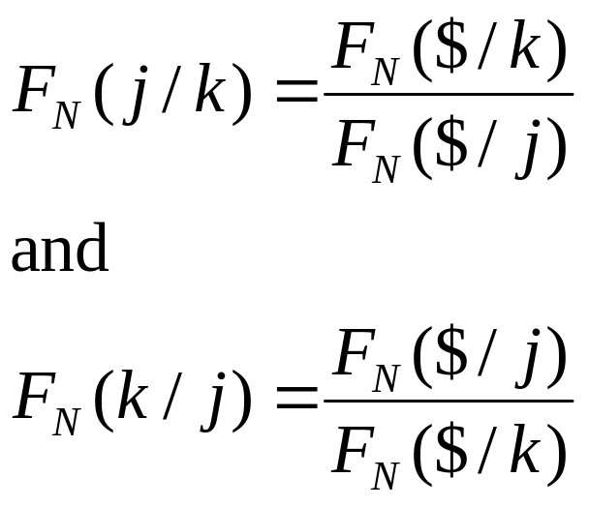
Forward Cross Exchange Rates
It’s just an “delayed” example of the spot cross rate discussed above.
In generic terms
Notice that the “$”s cancel.
5-<number>

Slide 45
Forward Cross Rates
Currencies |  |  | January 4, 2008
U.S.-dollar foreign-exchange rates in late New York trading.
 |  |  |  | --------Friday-------
 |  |  | Country/currency | in US$ | per US$
 |  |  | Euro area euro | 1.4744 | .6783
 |  |  | 1-mos forward | 1.4747 | .6781
 |  |  | 3-mos forward | 1.4744 | .6782
 |  |  | 6-mos forward | 1.4726 | .6791
 |  |  | UK pound | 1.9717 | .5072
 |  |  | 1-mos forward | 1.9700 | .5076
 |  |  | 3-mos forward | 1.9663 | .5086
 |  |  | 6-mos forward | 1.9593 | .5104
The 3-month forward €/£ cross rate is
$1.4744
£1.00
£0.7498
×
=
€1.00
$1.9663
€1.00
5-<number>

Slide 46
Cross-Currency Hedge
Suppose that you are a U.K.-based exporter who has sold €1,000,000 order to an Italian retailer. Payment due in 90 days. Hedge this into pounds.
 | --------Friday-------
Country/currency | in US$ | per US$
Euro area euro | 1.4744 | .6783
1-mos forward | 1.4747 | .6781
3-mos forward | 1.4744 | .6782
6-mos forward | 1.4726 | .6791
UK pound | 1.9717 | .5072
1-mos forward | 1.9700 | .5076
3-mos forward | 1.9663 | .5086
6-mos forward | 1.9593 | .5104
 | --------Friday-------
Country/currency | in US$ | per US$
Euro area euro | 1.4744 | .6783
1-mos forward | 1.4747 | .6781
3-mos forward | 1.4744 | .6782
6-mos forward | 1.4726 | .6791
UK pound | 1.9717 | .5072
1-mos forward | 1.9700 | .5076
3-mos forward | 1.9663 | .5086
6-mos forward | 1.9593 | .5104
Sell the euro forward for dollars
Buy the pound forward. If you had bid-ask spreads, then you sell the € at the bid and buy £ at the ask.
$1.4744
£1.00
€1m x
x
= £749,834.72
€1.00
$1.9663
5-<number>

Slide 47
Currency Symbols
In addition to the familiar currency symbols (e.g. £, ¥, €, $) there are three-letter codes for all currencies.
It is a long list, but selected codes include:
CHF Swiss francs
GBP British pound
ZAR South African rand
CAD Canadian dollar
JPY Japanese yen
5-<number>

Slide 48
SWAPS
A swap is an agreement to provide a counterparty with something he wants in exchange for something that you want.
  Often on a recurring basis—e.g. every six months for five years.
Swap transactions account for approximately 56 percent of interbank FX trading, whereas outright trades are 11 percent.
Swaps are covered fully in chapter 14.
5-<number>

Slide 49
Exchange Traded Currency Funds
An ETF where each share represents 100 euros.
Individual shares are denominated in the U.S. dollar and trade on the New York Stock Exchange.
  The price of one share at any point in time will reflect the spot dollar value of 100 euros plus accumulated interest minus expenses.
Six additional currency trusts exist on the Australian dollar, British pound sterling, Canadian dollar, Mexican peso, Swedish krona, and the Swiss franc.
Currency is now recognized as a distinct asset class, like stocks and bonds. Currency ETFs facilitate investing in these currencies.
5-<number>

Slide 50
Summary
Spot rate quotations
  Direct and indirect quotes
  Bid and ask prices
Cross Rates
  Triangular arbitrage
Forward Rate Quotations
  Forward premium (discount)
  Forward points
5-<number>

